Slide 1
Introduction to Computer Science (371-1-1601)
Lectures by: Dr. Dan Vilenchik & Dr. Zion Siksik
Recitations by: Ariel Cohen, Moshiko Davidian, Assaf Livne, Yair Mazal

Slide 2
Recitation 8 Recursions

Slide 3
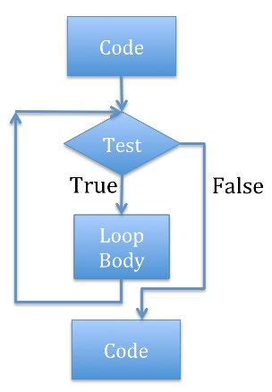
Reminder - solving iteratively with a loop
Factorial:
N! = 1*2*3*..*n-1*n

Slide 4
Reminder - solving iteratively with a loop
Check stop condition
Perform current calculation
Next iteration

Slide 5
Reminder - solving iteratively with a loop
def factorial(n): sum = 1 num = 1 while num <= n: sum *= num num += 1 return sum

Slide 6

solving iteratively with a recursion
def factorial2(n): if n == 1 | n == 0: return 1 if n > 1: return n* factorial2(n-1)

Slide 7
Factorial - example
factorial2(5)
Return 5*factorial2(4)
factorial2(4)
Return 4*factorial2(3)
factorial2(3)
Return 3*factorial2(2)
factorial2(2)
Return 2*factorial2(1)
factorial2(1)
Return 1
def factorial2(n): if n == 1 | n == 0: return 1 if n > 1: return n* factorial2(n-1)

Slide 8
solving iteratively with a recursion
Check stop condition
Next iteration
Perform current calculation
Remember induction?
If it works for N it will also work for N-1

Slide 9
Recursion example 2
What does example2() does?
def example2(num): if num == 0: return 0 return example2(num//10) + num % 10
Notes:
Calculates the sum of digits

Slide 10
Recursion example 2_5
A solution based on different stopping conditions
def example2_5(num): if num > 10: return num return example2(num//10) + num % 10
Notes:
Calculates the sum of digits

Slide 11
Thinking in Recursions tips
What is the stop condition?
What to do under this condition?
Small scale problem

Slide 12
Recursion example 3
What does example3() does?
def example3(str): if len(str) == 1: return str return example3(str[1:]) + str[0]
Notes:
Print the characters in reverse order

Slide 13
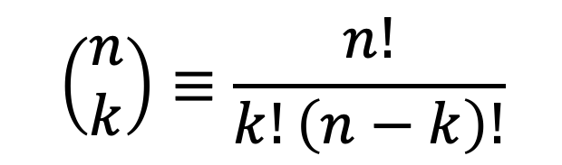
Choose k of n
$$\left(\begin{matrix}n \\ k\end{matrix}\right)≡\frac{n!}{k!\left(n−k\right)!}$$
Choosing k of n, unordered is denoted as:
*the number of possible combinations of k elements out of total n elements

Slide 14
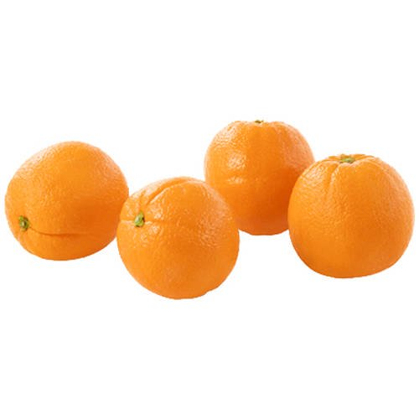
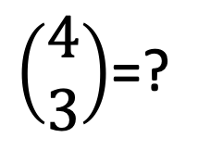
Choose k of n
For example lets say that I am at the grocery store and want to pick 3 oranges out of a total of 4 oranges. How many combinations can I pick?
$\left(\begin{matrix}4 \\ 3\end{matrix}\right)$=?

Slide 15
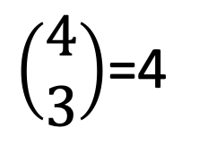
Choose k of n
For example lets say that I am at the grocery store and want to pick 3 oranges out of a total of 4 oranges. How many combinations can I pick?
I have 4 different oranges that I can choose not to pick.
$\left(\begin{matrix}4 \\ 3\end{matrix}\right)$=4
1
1
1
2
2
2
3
3
3
4
4
4

Slide 16
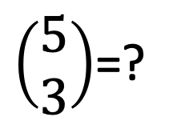
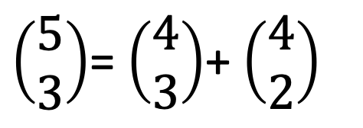
Choose k of n
$\left(\begin{matrix}5 \\ 3\end{matrix}\right)$=?
If they were a total of 5 oranges?
The fifth orange can either be chosen or not, so:
$\left(\begin{matrix}5 \\ 3\end{matrix}\right)$= $\left(\begin{matrix}4 \\ 3\end{matrix}\right)$+ $\left(\begin{matrix}4 \\ 2\end{matrix}\right)$
If we do not choose the fifth orange
If we choose the fifth orange

Slide 17
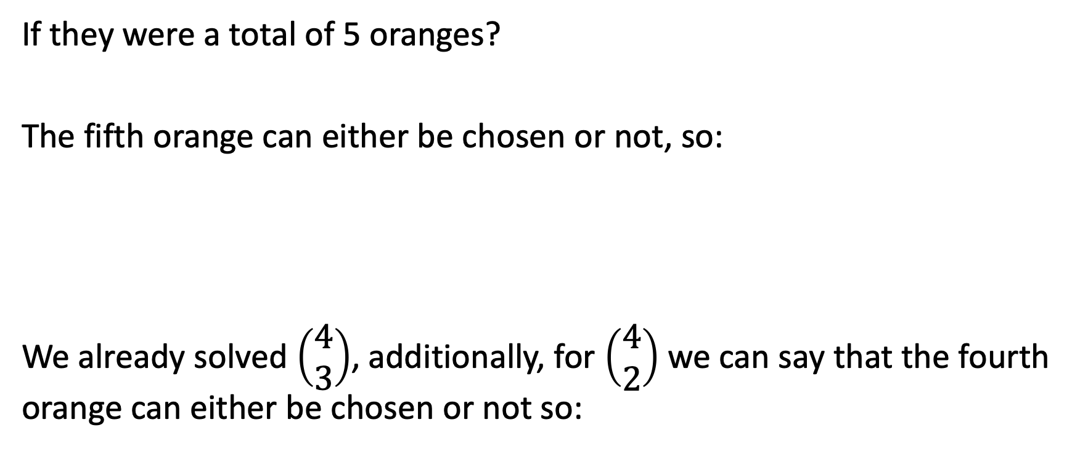
Choose k of n
$\left(\begin{matrix}5 \\ 3\end{matrix}\right)$=?
If they were a total of 5 oranges?
The fifth orange can either be chosen or not, so:
We already solved $\left(\begin{matrix}4 \\ 3\end{matrix}\right)$, additionally, for $\left(\begin{matrix}4 \\ 2\end{matrix}\right)$ we can say that the fourth orange can either be chosen or not so:
$\left(\begin{matrix}5 \\ 3\end{matrix}\right)$= $\left(\begin{matrix}4 \\ 3\end{matrix}\right)$+ $\left(\begin{matrix}4 \\ 2\end{matrix}\right)$

Slide 18
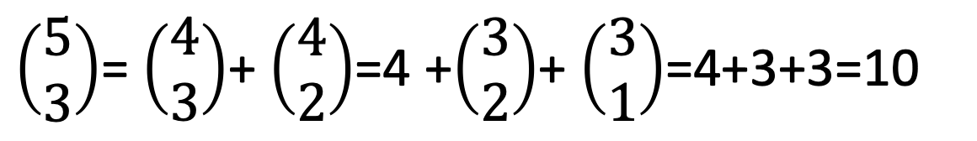
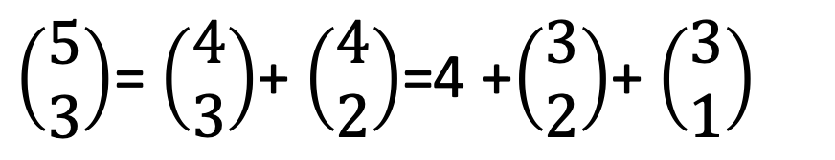
Choose k of n
Which can be continued to:
$\left(\begin{matrix}5 \\ 3\end{matrix}\right)$= $\left(\begin{matrix}4 \\ 3\end{matrix}\right)$+ $\left(\begin{matrix}4 \\ 2\end{matrix}\right)$=4 +$\left(\begin{matrix}3 \\ 2\end{matrix}\right)$+ $\left(\begin{matrix}3 \\ 1\end{matrix}\right)$
$\left(\begin{matrix}5 \\ 3\end{matrix}\right)$= $\left(\begin{matrix}4 \\ 3\end{matrix}\right)$+ $\left(\begin{matrix}4 \\ 2\end{matrix}\right)$=4 +$\left(\begin{matrix}3 \\ 2\end{matrix}\right)$+ $\left(\begin{matrix}3 \\ 1\end{matrix}\right)$=4+3+3=10

Slide 19
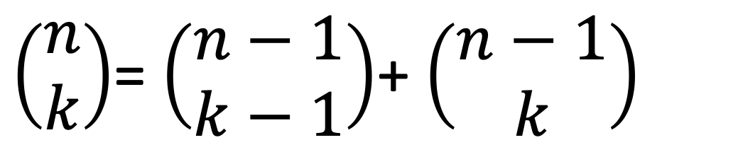
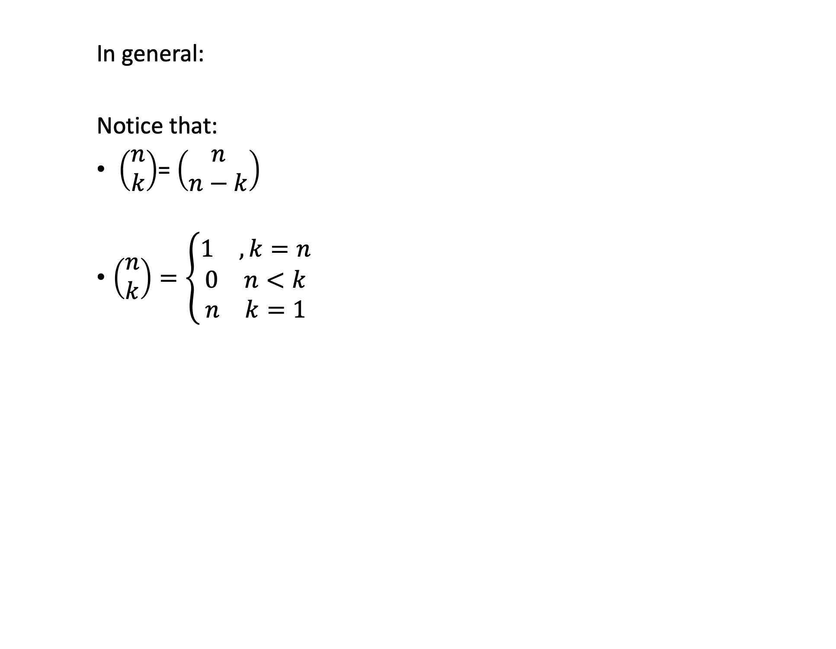
Choose k of n
$\left(\begin{matrix}n \\ k\end{matrix}\right)$= $\left(\begin{matrix}n−1 \\ k−1\end{matrix}\right)$+ $\left(\begin{matrix}n−1 \\ k\end{matrix}\right)$
In general:
Notice that:
$\left(\begin{matrix}n \\ k\end{matrix}\right)$= $\left(\begin{matrix}n \\ n−k\end{matrix}\right)$
$\left(\begin{matrix}n \\ k\end{matrix}\right)=\left\{\begin{aligned}\begin{matrix}1 & ,k=n\end{matrix} \\ \begin{matrix}0 & n<k\end{matrix} \\ \begin{matrix}n & k=1\end{matrix}\end{aligned}\right.$

Slide 20
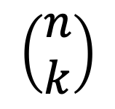
Recursion example 4 choose k of n
$$\left(\begin{matrix}n \\ k\end{matrix}\right)$$
Choosing k of n:
def example4(n, k): if n < k: return 0 if (k == 1) | (n-k == 1): return n if k == n: return 1 return example4(n-1, k-1) + example4(n-1, k)

Slide 21
Permutations
Another problem that can be solved with recursion is permutations.
More specifically permutation with repetition:
For example: choose 3 elements from [2,7,11,3]

Slide 22

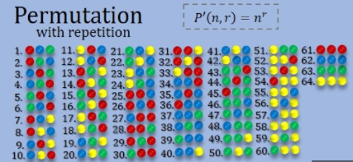
Permutations
For example: choose 3 elements from [2,7,11,3] with repetition
[2,2,2], [2,7,2], [2,7,7], [2,7,11], [2,7,3], [2,11,2] …
How many combinations?

Slide 23
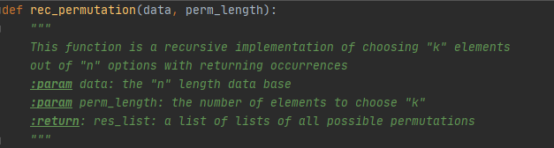
Permutations
General case: Choose sets of length “r”, comprised of elements from set of size “k”
How many combinations ?
How can we write the code ?
Take a few minutes to try for yourself

Slide 24

Case study: power operator
def power1(num, power): # loop implementation of power operator res = 1 for i in range(power): res *= num return res

Slide 25
Case study: power operator
Let's try to do it with a recursion:

Slide 26
Case study: power operator
Lets try to do it with a recursion:
def power2(num, power): print(power) if power == 1: return num if power == 0: return 1 return num*power2(num, power-1)

Slide 27
Case study: power operator
How can we improve the run time?

Slide 28

Case study: power operator
$$x^{n}=x∙x…∙x$$

Slide 29

Case study: power operator
$$x^{n}=x∙x…∙x$$
Or
$$x^{n}=x^{n−1}∙x=x^{n−2}∙x^{2}=…=x^{n/2}∙x^{n/2}$$

Slide 30

Case study: power operator
$$x^{n}=x∙x…∙x$$
Or
$$x^{n}=x^{n−1}∙x=x^{n−2}∙x^{2}=…=x^{n/2}∙x^{n/2}$$
Or
$$x^{n}={\left(x^{\frac{n}{2}}\right)}^{2}$$

Slide 31

Case study: power operator
Finally we can write:
$$x^{n}=\left\{\begin{aligned}1, n=0 \\ x∙x^{n−1}, n odd \\ &{\left(x^{\frac{n}{2}}\right)}^{2}, n even\end{aligned}\right.$$

Slide 32
Case study: power operator
def power3(num, power): if power == 0: return 1 if power % 2: return num*power3(num, power-1) tmp = power3(num, power/2) return tmp*tmp

Slide 33

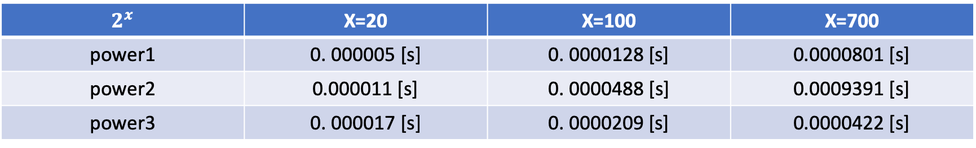
Case study: power operator – run time comparison
$$2^{x}$$ | X=20 | X=100 | X=700
power1 | 0. 000005 [s] | 0. 0000128 [s] | 0.0000801 [s]
power2 | 0.000011 [s] | 0. 0000488 [s] | 0.0009391 [s]
power3 | 0. 000017 [s] | 0. 0000209 [s] | 0.0000422 [s]

Slide 34
Exercise
Write a Python program to calculate the sum of the positive integers of n+(n-2)+(n-4)... (until n-x =< 0).
Test Data: sum_series(6) -> 12 sum_series(10) -> 30

Slide 35
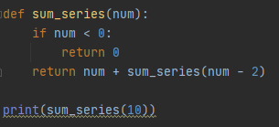
solution
def sum_series(num):
if num < 0:
return 0
return num + sum_series(num - 2)
print(sum_series(10))

Slide 36
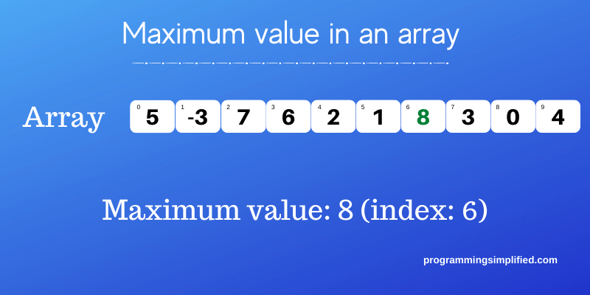
Exercise
Write a recursive Python function that has a parameter representing a list of integers and returns the maximum stored in the list.

Slide 37
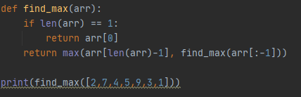
solution
def find_max(arr):
if len(arr) == 1:
return arr[0]
return max(arr[len(arr)-1], find_max(arr[:-1]))
print(find_max([2,7,4,5,9,3,1]))

